Slide 1

Chapter 2
Waveguide

Slide 2

Chapter Outlines
Chapter 2 Waveguide
Rectangular Waveguide Fundamentals
Waveguide Field Equations
Parallel Plate Waveguide
Rectangular Waveguide Modes
Cylindrical Waveguide Fundamentals
Cylindrical Waveguide Modes
Resonant Cavity
Dielectric Waveguide

Slide 3

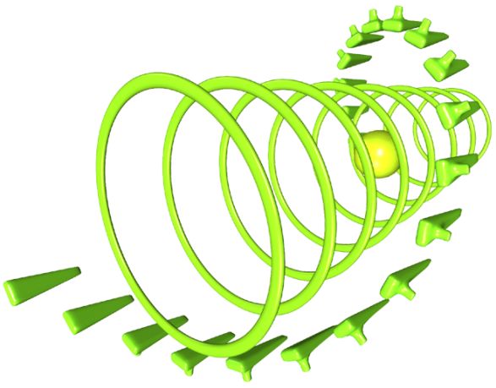
Introduction
WAVEGUIDE → any structure that supports propagation of a wave. In general usage:
The term waveguide refers to constructs that only support non TEM mode propagation, name in the TE and TM Mode.
It also unable to support wave propagation below a certain frequency, or cutoff frequency

Slide 4

Introduction (Cont’d..)
A waveguide is another means of guiding the EM energy from one point to another (same as transmission line). Some differences between waveguide and transmission line (TLine) :
TLine can only support TEM wave whereas waveguide can support many possible field configurations.

Slide 5
Introduction (Cont’d..)
At microwave frequencies (3 to 300 GHz), TLine becomes inefficient due to skin effect and dielectric losses, but waveguides are used at microwave frequencies to obtain larger bandwidth and lower signal attenuation.
TLine can operate above dc (f =0) to a very high frequency, but waveguide can operate only above cutoff frequency and therefore acts as a high pass filter.

Slide 6
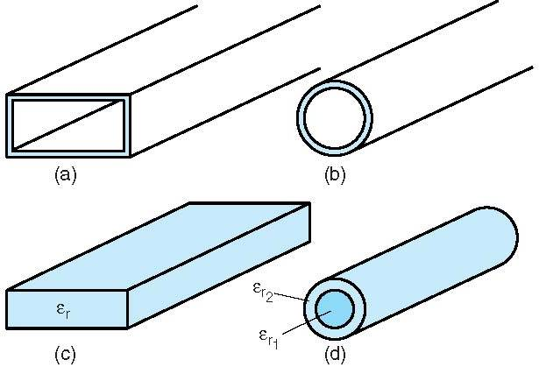
Introduction (Cont’d..)
The most common waveguide types:

Slide 7
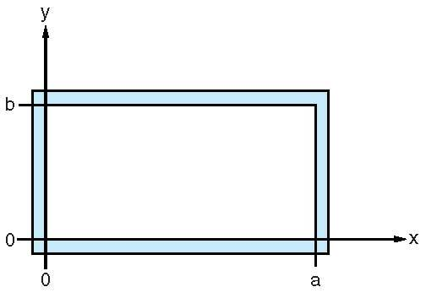
1.1 Rectangular Waveguide Fundamentals
A cross section of rectangular waveguide is shown below:
Propagation is in the +z direction or out of page.
Conducting walls → brass, copper or aluminium.
Chosen to be thick enough for mechanical rigidity and several skin depths over the frequency of interest.
The inside wall → electroplated with silver or gold to improve performance

Slide 8
Rectangular Waveguide Fundamentals (Cont’d..)
The interior dimensions are a x b, where the longer side is a.
‘a’ dimension:
Determines the frequency range of the dominant, or lowest order, the mode of propagation.
Usually operates in lowest propagating mode, since higher order → higher attenuation + difficult to extract from guide.
‘b’ dimension:
Affects attenuation, smaller b has higher attenuation.
Also sets the max power capacity
Usually half of the ‘a’ dimension

Slide 9
Rectangular Waveguide Fundamentals (Cont’d..)
Waveguide can support TE and TM modes, where:
In TE Modes, the electric field is transverse to the direction of propagation. Some magnetic field component in the direction of propagation.
In TM Modes, the magnetic field is transverse and an electric field component must be in the propagation direction.

Slide 10
Rectangular Waveguide Fundamentals (Cont’d..)
The order of the mode refers to the field configuration in the guide and is given by ‘m’ and ‘n’ integer subscripts, as TE_{mn} and TM_{mn}.
The ‘m’ subscript corresponds to the number of half wave variations of the field in x direction
The ‘n’ subscript corresponds to the number of half wave variations of the field in y direction

Slide 11
Rectangular Waveguide Fundamentals (Cont’d..)
In conjunction with the guide dimensions, m and n determine the cutoff frequency for a particular mode.
For conventional rectangular waveguide filled with air, where a = 2b, the dominant or lowest order mode is TE₁₀ with cutoff frequency fc₁₀ = c/2a

Slide 12
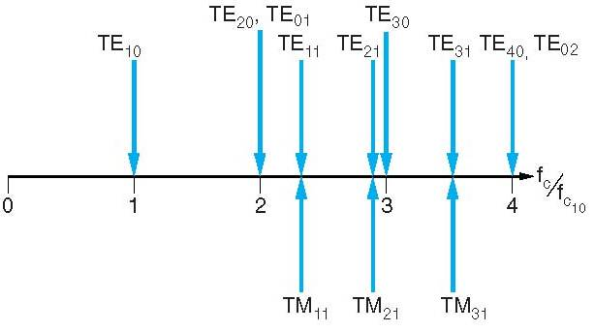
Rectangular Waveguide Fundamentals (Cont’d..)
The relative cutoff frequencies for the first 12 modes of conventional rectangular waveguide filled with air,
Location of modes relative to the dominant TE₁₀ mode in standard rectangular waveguide where a=2b.

Slide 13
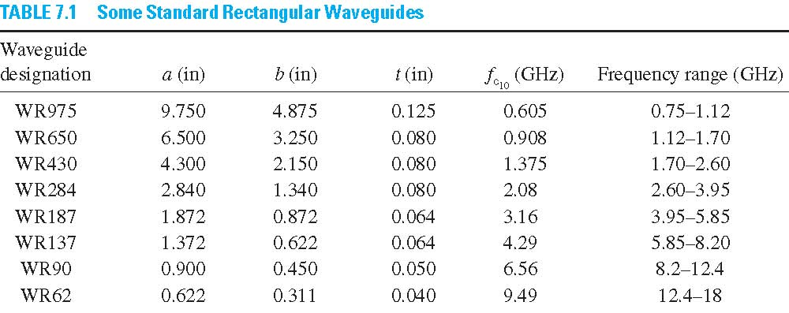
Rectangular Waveguide Fundamentals (Cont’d..)

Slide 14
Example 1
Calculate the cutoff frequency for the first four modes of WR284 waveguide.

Slide 15
Solution to Example 1
From table, the guide dimensions are a=2.840 inches and b=1.340 inches. Converting to metric units:
Therefore,
where

Slide 16
Solution to Example 1(Cont’d..)
Then, we have:
This agrees with the cutoff frequency cited in table. Then :
not same with fc₁₀ since a ≠ 2b

Slide 17
Solution to Example 1(Cont’d..)
and for the fourth mode,

Slide 18
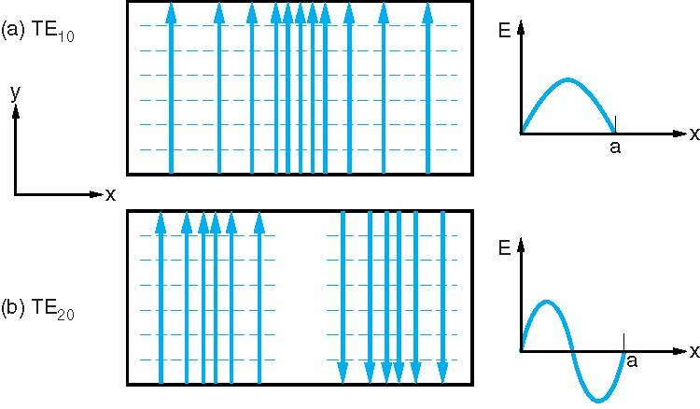
Rectangular Waveguide Fundamentals (Cont’d..)
The field pattern for two modes where E only varies in the x direction, since n=0, the field is constant in the y direction.
The field patterns and associated field intensities in a cross section of rectangular waveguide for (a) TE₁₀ and (b) TE₂₀. Solid lines indicate electric field; dashed lines are the magnetic field.

Slide 19
1.2 Waveguide Field Equations
Beginning with Maxwell’s equations, develop the time harmonic field equations for rectangular waveguide. For simplicity, consider the guide filled with lossless, charge free media and the walls to be perfect conductors.

Slide 20
Waveguide Field Equations (Cont’d..)
For conventional rectangular waveguide, the field components in Cartesian coordinates are:
Inserting these equations into previous Maxwell’s equation..

Slide 21
Waveguide Field Equations (Cont’d..)
From previous divergence equations,

Slide 22
Waveguide Field Equations (Cont’d..)
From previous wave equation,

Slide 23
Waveguide Field Equations (Cont’d..)
From the first expanded Maxwell’s equations,

Slide 24
Waveguide Field Equations (Cont’d..)
Then, consider the fields only propagate in the z direction, in harmonic fields:
The partial derivative with respect to z is:
Substitute these into the expanded Maxwell’s equations

Slide 25
Waveguide Field Equations (Cont’d..)
Those equations can be reduced to:

Slide 26
Waveguide Field Equations (Cont’d..)
Wave equations also can be reduced to:
With,

Slide 27
Waveguide Field Equations (Cont’d..)
So, using these equations, we can find expression for the four transverse components (E_{x}, E_{y}, H_{x}, H_{y}) in terms of z directed components (E_{z} and H_{z}), where:
(1)
(2)

Slide 28
Waveguide Field Equations (Cont’d..)
And also..
(3)
(4)
Try to derive these four equations on your own!

Slide 29
Waveguide Field Equations (Cont’d..)
So, these four important equations will be used to find the transverse components for TM and TE mode, where:
for TM mode, H_{z}=0, then use these four equations to find the transverse components.
for TE mode, E_{z}=0, then use these four equations to find the transverse components.

Slide 30
Waveguide Field Equations (Cont’d..)
for TM mode, H_{z}=0, equation (1) to (4) can be reduced to:
(5)
(6)
(7)
(8)

Slide 31
Waveguide Field Equations (Cont’d..)
for TE mode, E_{z}=0, equation (1) to (4) can be reduced to:
(9)
(10)
(11)
(12)

Slide 32
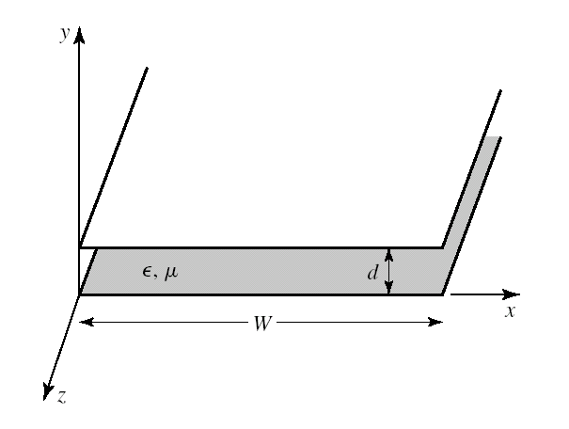
1.3 Parallel Plate Waveguide
The parallel plate waveguide is the simplest type of guide that can support TM and TE Modes, and TEM as well because it’s formed from two plates as shown.
The width W is assumed to be much greater than the separation d, so that fringing fields and any x variation can be ignored. A material with permittivity ε_{r} and permeability µ_{r} is assumed to fill the region between the two plates.

Slide 33
Parallel Plate Waveguide (Cont’d..)
By considering the boundary condition, the magnitude E will change with y, E=0 at y=0 and at y=a but maximum in the middle. Magnitude E will not change with x since x is infinity (no boundary), so the value will constant . The E will along the propagation i.e. +z direction. Thus,
y=a
z
y=0
x

Slide 34
Parallel Plate Waveguide Modes (Cont’d..)
For TM Mode
For TM Mode, the magnetic field has its components transverse or normal to the direction of wave propagation, where H_{z}=0 and a nonzero E_{z} fields. So,
Since the field is gong to +z direction, it can be reduced to only:

Slide 35
Parallel Plate Waveguide TM Modes (Cont’d..)
With , solution for this is:
At y=0 E_{zs} =0 , thus
Hence B=0
At y=a E_{z} =0
This valid if
or
n=1,2,3,4….

Slide 36
Parallel Plate Waveguide TM Modes (Cont’d..)
Thus with ,
Then, from equation (5) to (8), since d/dx=0, so only (5) and (7) remain, therefore:

Slide 37
Parallel Plate Waveguide Modes (Cont’d..)
For TE Mode
For TE Mode, the electric field has its components transverse or normal to the direction of wave propagation, where E_{z}=0 and a nonzero H_{z} fields. So,
Since the field is gong to +z direction, it can be reduced to only:

Slide 38
Parallel Plate Waveguide TE Modes (Cont’d..)
With , solution for this is:
But, the boundary are that E_{x}=0 at y=0,a. So that from (10),
At y=0 E_{x} =0 , thus
Hence A=0

Slide 39
Parallel Plate Waveguide TE Modes (Cont’d..)
At y=a E_{x} =0
This valid if
or
n=1,2,3,4….
Thus with , and get back the solution for H_{z},

Slide 40
Parallel Plate Waveguide TE Modes (Cont’d..)
Then, from equation (9) to (12), since d/dx=0, so only (10) and (12) remain, therefore:

Slide 41
1.4 Rectangular Waveguide Modes
For TM Mode
For TM Mode, the magnetic field has its components transverse or normal to the direction of wave propagation. At the walls of the waveguide, the tangential components of the E field must be continuous, that is:

Slide 42
Rectangular Waveguide TM Modes (Cont’d..)
For TM mode, H_{z}=0, then lets:
Where X is a function of x and Y is a function of y
Then the wave equation becomes:

Slide 43
Transitional Page
Rectangular Waveguide TM Modes (Cont’d..)
We divide the equation by XY
Let’s
and then
or
and

Slide 44
Rectangular Waveguide TM Modes (Cont’d..)
Solution for both equations:
And the whole expression becomes:

Slide 45
Transitional Page
Rectangular Waveguide TM Modes (Cont’d..)
We know that the tangential electric fields at the walls of the waveguide must be zero. Then by applying the boundary conditions:
Applying boundary condition at x=0 where E_{z}=0
So C₁=0
Applying boundary condition at y=0 where E_{z}=0
So D₁=0

Slide 46
Rectangular Waveguide TM Modes (Cont’d..)
Then the equation reduced to
Applying the other boundary condition x=a where E_{z} =0
E₀ and sin k_{y}y cannot be zero
This means that sin k_{x}a = mπ = 0 or
where m=0,1,2,3,4…

Slide 47
Transitional Page
Rectangular Waveguide TM Modes (Cont’d..)
Applying the other boundary condition y=b where E_{z} =0
But E₀ and sin k_{x}x cannot be zero,
This means that sin k_{y}b = 0 or
where n =0,1,2,3,4…
So,

Slide 48
Rectangular Waveguide TM Modes (Cont’d..)
Then, substitute H_{zs}=0 and we have:

Slide 49
Transitional Page
Rectangular Waveguide TM Modes (Cont’d..)
and also..
Denote as TM_{mn} ,the field vanish for TM₀₀ , TM₁₀ and TM₀₁. The lowest mode is TM₁₁

Slide 50
Rectangular Waveguide TM Modes (Cont’d..)
Useful relations to be remember,
Wave number,
The propagation constant is:
where

Slide 51
Transitional Page
Rectangular Waveguide TM Modes (Cont’d..)
Where we have 3 possibilities depending on k (or ω), m and n:
Cutoff mode :
At this time, ω is called cutoff angular frequency:

Slide 52
Rectangular Waveguide TM Modes (Cont’d..)
Evanescent mode :
We have no propagation at all. These non propagating or attenuating modes are said to be evanescent.
Propagating mode :

Slide 53
Transitional Page
Rectangular Waveguide TM Modes (Cont’d..)
Where the phase constant becomes:
For each mode (combination of m and n) thus has a cutoff frequency fc_{mn} given by:
The cutoff frequency is the operating frequency below which attenuation occurs and above which propagation takes place.

Slide 54
Rectangular Waveguide TM Modes (Cont’d..)
The cutoff wavelength,
The phase constant,
The intrinsic wave impedance,
Where,
Intrinsic impedance in the medium

Slide 55
Rectangular Waveguide Modes (Cont’d..)
For TE Mode
For TE Mode, the electric field has its components transverse or normal to the direction of wave propagation. At the walls of the waveguide, the tangential components of the E field must be continuous, that is:

Slide 56
Transitional Page
Rectangular Waveguide TE Modes (Cont’d..)
For TE mode, E_{z}=0, then lets:
Where X is a function of x and Y is a function of y
From previous derivation, the wave equation becomes:

Slide 57
Rectangular Waveguide TE Modes (Cont’d..)
H_{z} cannot impose boundary condition since it is not zero at boundary, so we determine E_{x} and E_{y} as follow :
From,
it becomes:
Then reduced to:

Slide 58
Transitional Page
Rectangular Waveguide TE Modes (Cont’d..)
From,
it becomes:
Then reduced to:

Slide 59
Rectangular Waveguide TE Modes (Cont’d..)
Then by applying the boundary conditions:
Applying boundary condition at y=0 where E_{x}=0
So D₂=0, then applying boundary condition at x=0 where E_{y}=0
So C₂=0

Slide 60
Transitional Page
Rectangular Waveguide TE Modes (Cont’d..)
Applying the other boundary condition x=a where E_{y} =0
This means that sin k_{x}a = 0 or
where m=0,1,2,3,4…
Applying the other boundary condition y=b where E_{x} =0
This means that sin k_{y}b = 0 or
where n=0,1,2,3,4…

Slide 61
Rectangular Waveguide TE Modes (Cont’d..)
So,
So,
Then, substitute E_{z}=0 and we have:

Slide 62
Transitional Page
Rectangular Waveguide TE Modes (Cont’d..)
and also..
Denote as TE_{mn} ,the field vanish for TE₀₀. The lowest mode is TE₁₀ for a>b and TE₀₁ for b>a.

Slide 63
Rectangular Waveguide Modes (Cont’d..)
From equations for the TM and TE modes, we can obtain the field patterns..
For example, the dominant TE₁₀ mode, where m = 1 and n = 0, so the E_{x}, E_{y}, H_{x}, H_{y} and H_{z} equations becomes,
So then in the time domain,

Slide 64
Rectangular Waveguide Modes (Cont’d..)
Similarly..

Slide 65
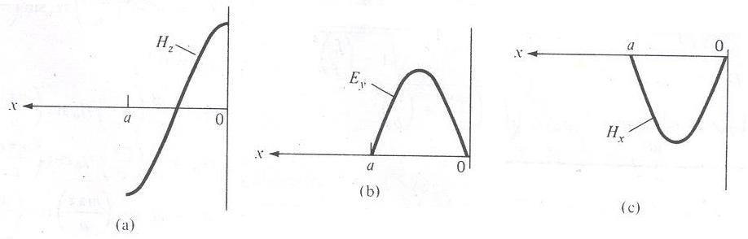
Rectangular Waveguide Modes (Cont’d..)
So, for TE₁₀ mode, the variation of the E and H fields with x in an xy plane, say plane cos (ωt-βz)=1 for H_{z} and plane sin (ωt-βz)=1 for E_{y} and H_{x}

Slide 66
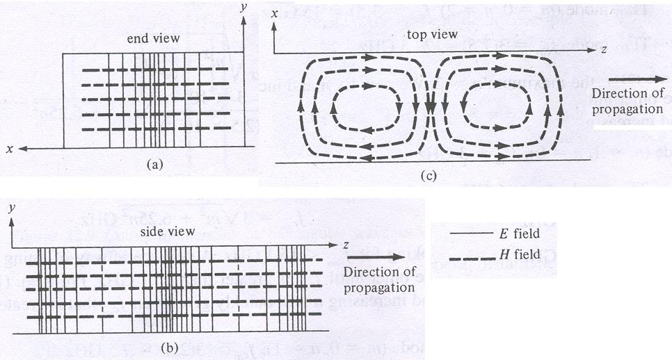
Rectangular Waveguide Modes (Cont’d..)
The corresponding field lines:

Slide 67
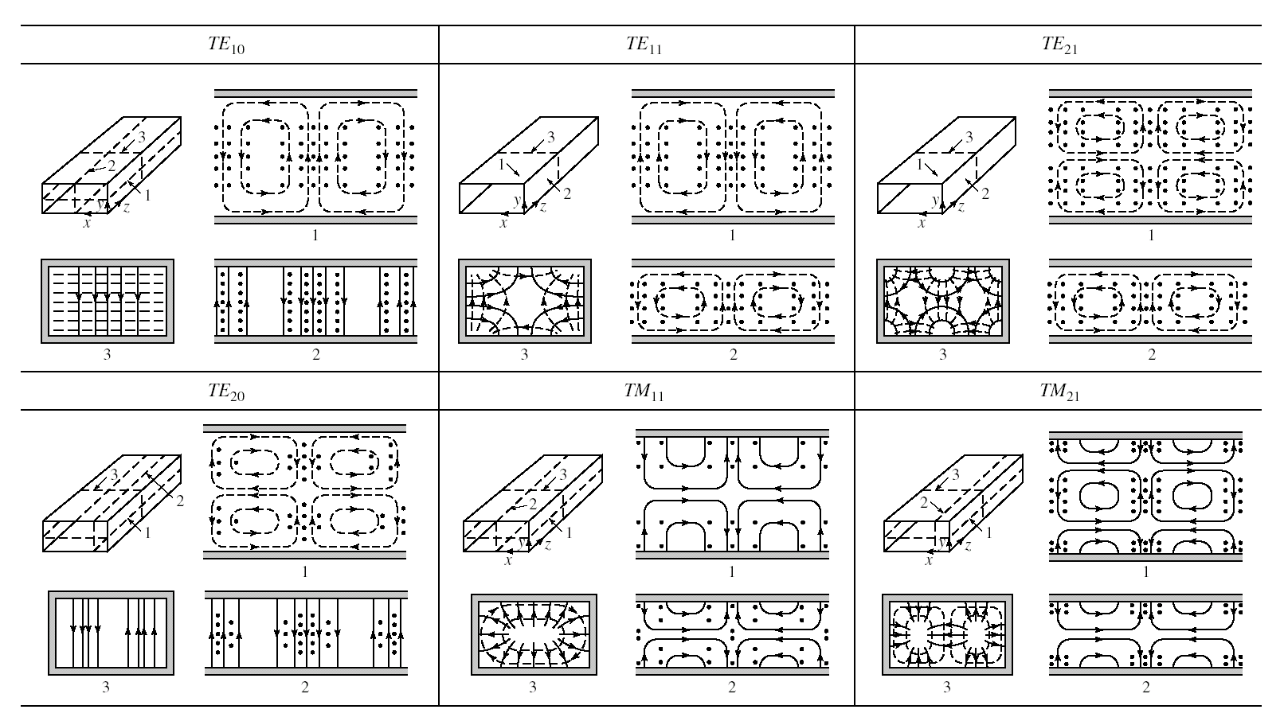
Rectangular Waveguide Modes (Cont’d..)
Field lines for some of the lower order modes of a rectangular waveguide :

Slide 68
Example 2
A rectangular waveguide with dimension a=2.5 cm, and b=1 cm is to operate below 15.1 GHz. How many TE and TM modes can the waveguide transmit if the guide is filled with medium characterized by σ=0, µ_{r}=1, ε=4ε₀. Calculate the cutoff frequencies of the modes.

Slide 69
Solution to Example 2
The cutoff frequency is given by:
With a = 2.5b or a/b = 2.5,
So,
Or,

Slide 70
Solution to Example 2 (Cont’d..)
Since we are looking for cutoff freq below 15.1 GHz, a systematic way is to fix m or n and increase the other until fc_{mn} is greater than 15.1 GHz. So, by fixing m and increasing n,
Thus, for fc_{mn} < 15.1 GHz, the maximum n = 2.

Slide 71
Solution to Example 2 (Cont’d..)
Then, fix n and increase m,
Thus, for fc_{mn} < 15.1 GHz, the maximum m = 5.

Slide 72
Solution to Example 2 (Cont’d..)
We know the maximum value of m and n, so try other possible combinations in between the maximum values.

Slide 73
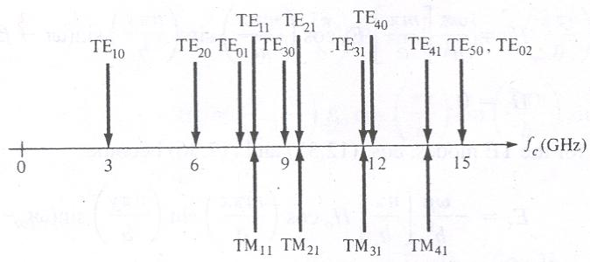
Solution to Example 2 (Cont’d..)
Those modes whose cutoff freq are less or equal to 15.1 GHz will be transmitted, that is 11 TE modes and 4 TM modes, as illustrated below:

Slide 74
Example 3
In a rectangular waveguide with dimension a=1.5 cm, b=0.8 cm, σ=0, µ=µ₀, ε=4ε₀, find:
The mode of operation
The cutoff frequency
The phase constant
The propagation constant
The intrinsic wave impedance

Slide 75
Solution to Example 3
We could find that the given expression is in instantaneous field expression form which obtained from the phasor forms by using:
From the given expression we could find that m=1, and n=3. That is the guide is operating at TM₁₃ or TE₁₃.
Suppose that after this, we choose TM₁₃ mode.

Slide 76
Solution to Example 3 (Cont’d..)
Where for air filled waveguide,
Hence, for m=1 and n=3, the cutoff frequency is:

Slide 77
Solution to Example 3 (Cont’d..)
The phase constant,
Where,
or

Slide 78
Solution to Example 3 (Cont’d..)
The propagation constant,
Because it’s in propagating mode,
So,
The intrinsic wave impedance,

Slide 79
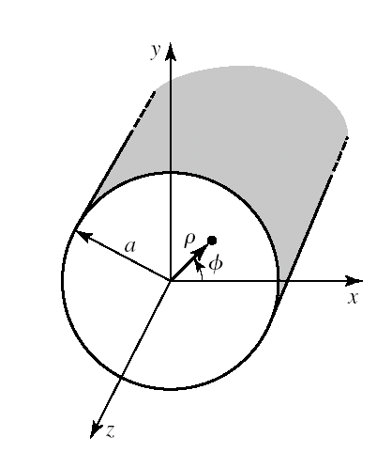
Transitional Page
1.5 Cylindrical Waveguide Fundamentals
A hollow metal tube of circular cross section also supports TE and TM waveguide modes as shown.

Slide 80
Cylindrical Waveguide Fundamentals (Cont’d..)
For cylindrical waveguide, the field components is in cylindrical coordinates which are:
Inserting these equations into previous Maxwell’s equation,

Slide 81
Transitional Page
Cylindrical Waveguide Fundamentals (Cont’d..)
By using the same method of derivation for rectangular waveguide (starting from slide 21), we could get four equations of E_{ρ}, E_{φ}, H_{ρ} and H_{φ} in terms of E_{z} and H_{z}
(13)
(14)
(15)
(16)
Try this!!!!

Slide 82
1.6 Cylindrical Waveguide Modes
For TM Mode
For the TM modes of the circular waveguide, we must solve Ez from the wave equation in cylindrical coordinates, then through a very long and difficult derivation, we could get the transverse fields as:

Slide 83
Transitional Page
Cylindrical Waveguide TM Modes (Cont’d..)
and also..

Slide 84
Cylindrical Waveguide TM Modes (Cont’d..)
Some useful parameters for TM mode:
Wave impedance for TM modes
Cutoff wavenumber
Propagation constant of the TM_{nm} modes
Cutoff frequency

Slide 85
Transitional Page
Cylindrical Waveguide TM Modes (Cont’d..)
Values of p_{nm} for TM Modes of a Circular Waveguide
n | p_{n1} | p_{n2} | p_{n3}
0 | 2.405 | 5.520 | 8.654
1 | 3.832 | 7.016 | 10.174
2 | 5.135 | 8.417 | 11.620
p_{nm} is the roots of J_{n}(x) which recognized as solution for Bessel’s differential equation.

Slide 86
Cylindrical Waveguide Modes (Cont’d..)
For TE Mode
For the TE modes of the circular waveguide, we must solve Hz from the wave equation in cylindrical coordinates, after which we could get the transverse fields as:

Slide 87
Transitional Page
Cylindrical Waveguide TE Modes (Cont’d..)
and also..

Slide 88
Cylindrical Waveguide TE Modes (Cont’d..)
Some useful parameters for TE mode:
Wave impedance for TE modes
Cutoff wavenumber
Propagation constant of the TE_{nm} modes
Cutoff frequency

Slide 89
Transitional Page
Cylindrical Waveguide TE Modes (Cont’d..)
Values of p’_{nm} for TE Modes of a Circular Waveguide
n | p'_{n1} | p’_{n2} | p’_{n3}
0 | 3.832 | 7.016 | 10.174
1 | 1.841 | 5.331 | 8.536
2 | 3.054 | 6.706 | 9.970
p’_{nm} is the roots of J_{n}(x) which recognized as solution for Bessel’s differential equation.

Slide 90
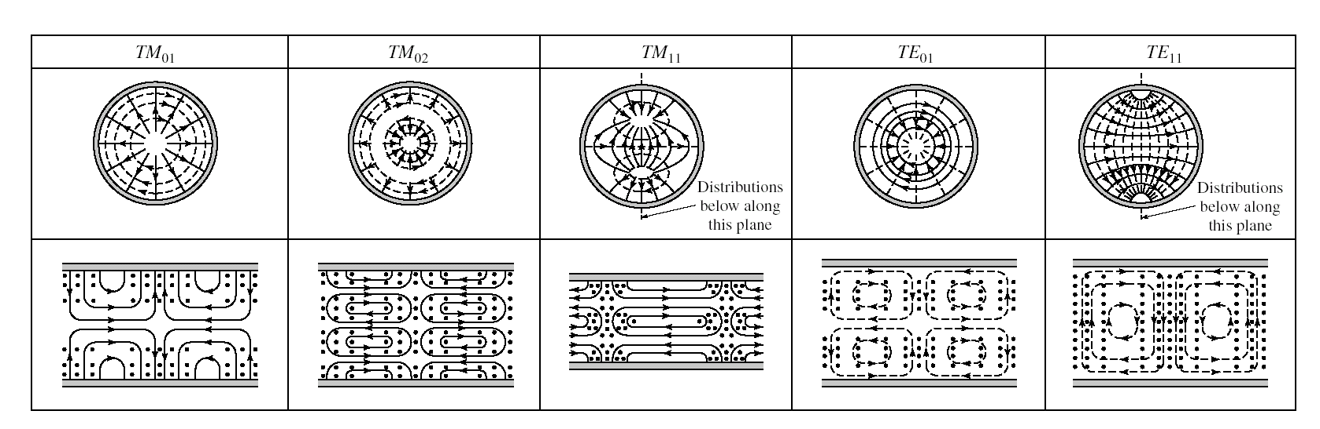
Field lines for some of the lower order modes of a cylindrical waveguide :

Slide 91
1.7 Resonant Cavity
The length of resonator, d is made multiple of waveguide wavelength, i.e.
p =1,2,3……
Resonator wavelength can be calculated as :
where

Slide 92
Resonant Cavity (Cont’d..)
And k_{c} for rectangular waveguide
For cylindrical wave guide
TM mode
TE mode

Slide 93
Example 4
A cylindrical resonator has a radius of 5cm which is used to measure frequency from 8GHz to 12GHz at TE₁₁ mode . What is the required length, d for tuning those frequency in that particular mode.

Slide 94
Solution to Example 4
First we calculate the cutoff wavelength
First frequency wavelength at 8 GHz,
Second frequency wavelength at 12 GHz,

Slide 95
Solution to Example 4 (Cont’d..)
Calculate the length of wave guide
For first frequency at 8 GHz,
For second frequency at 12 GHz,

Slide 96
Solution to Example 4 (Cont’d..)
So, the cavity need to have length, d in this range in order to make the cavity operates at resonant frequencies between 8GHz to 12 GHz:

Slide 97
1.8 Dielectric Waveguide
Air filled wave guide
Dielectric filled wave guide

Slide 98

Chapter 2
Waveguide
End

